Slide 1


Knight Vision Huron Grants & Workday Training June 2022 Facilitated by the Knight Vision Grants & GRIT Teams

Slide 2
Agenda
Terminology
Understanding Awards and Grants in Workday
What is new?
What is the same?
Processing Awards and Modifications (Scenarios)
HRS Change Management
Resources and Office Hours
Timeline
Workday Award/Grant Navigation Demo

Slide 3
Terminology – FDM

Slide 4
Terminology – Award/Grants

Slide 5
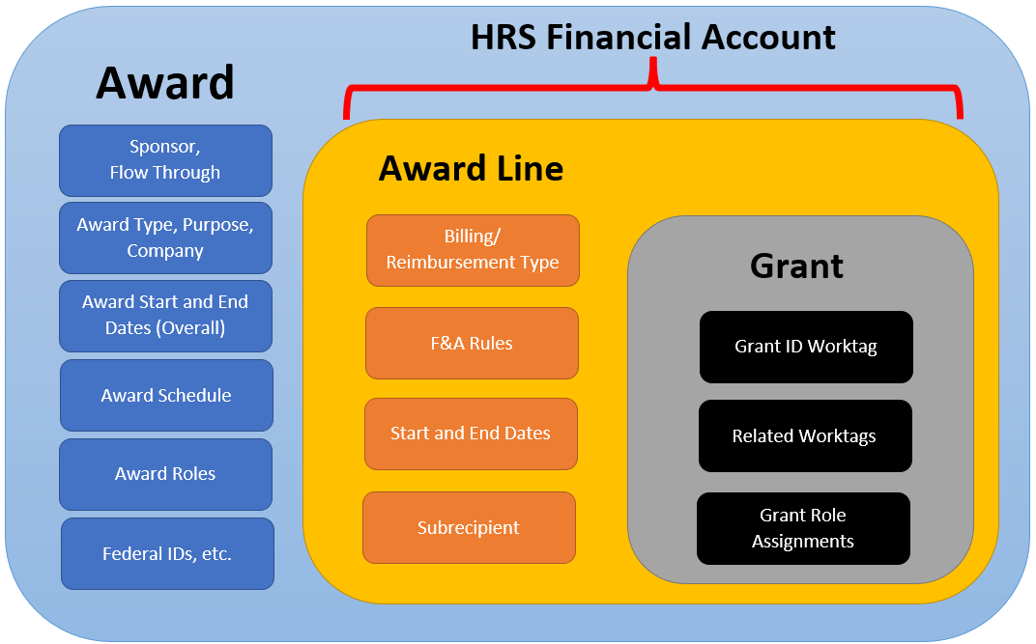
Understanding Awards and Grants in Workday

Slide 6
What is new in Huron Grants?
New fields on Award and Modification SmartForms
Grant IDs are sequential (no logic based on Dept, Funding Source, etc.)
Ability to update more HRS fields via a modification
Workday supports multiple Special Conditions from HRS
Administrative Contact required for all Awards
Sponsor names are now spelled out (e.g., “Natl” is now “National”)
New Patient Care category on Proposal Budgets and Budget Reconciliation page for new Awards
Site Search supports search by new Grant ID
More Help Text!

Slide 7
What is the same in Huron Grants?
New Award and Modification workflow
Sponsor change requires a new award
Award Modification Request (AMR) SmartForm
Modification Types
Managing budget vs award dollars on budget allocations (e.g., negative awards in reporting)
Ancillary Reviews, Credit Splits, Deliverables
Subawards SmartForm

Slide 8
Processing Awards and Modifications
The Award and Modification workflows are the same in HRS
Revised Award and Modification SmartForms

Slide 9
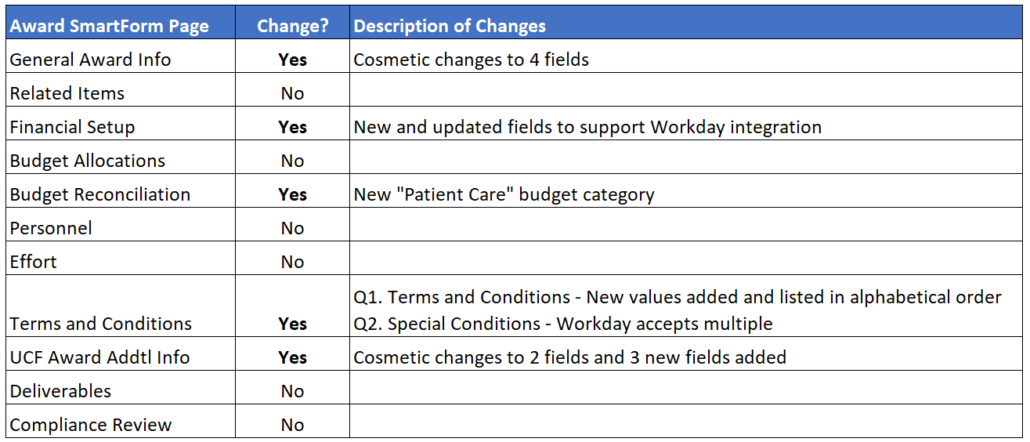
Huron Grants – Award SmartForm Changes

Slide 10
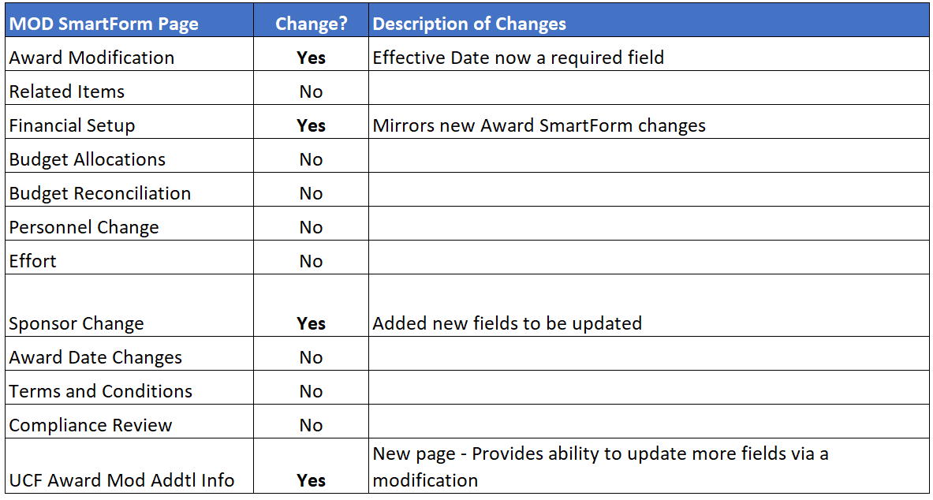
Huron Grants – Mod SmartForm Changes

Slide 11
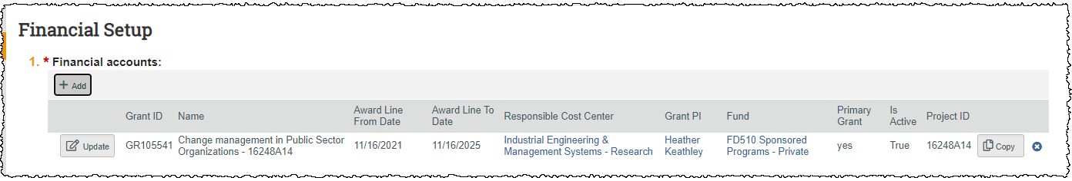
Award SmartForm – Financial Setup
Grant ID
Project ID displayed for converted awards

Slide 12
Award SmartForm – Financial Setup (Add/Edit view)

Slide 13
Award SmartForm – Financial Setup (Add/Edit view)
Award Line Type
Cost Reimbursable or Fixed
No Bill = Cost Reimbursable
Revenue Category
Similar to Project Type (Federal, State, Private, Flow-through, Match, I4 Awards, etc.)
New Preeminent Postdoctoral Program (P3) category
Financial Site
ST101 Main for Main Campus, ST110 Arecibo Observatory, etc.
Each Cost Center has a default Fin. Site, but some could have multiple, so Department should confirm or change if needed
Is this Grant for Cost Sharing?
This drives the amounts integrated to Workday
1 cost share grant for each source

Slide 14
Award SmartForm – Financial Setup (Add/Edit view)
Is this Grant for an Outgoing Subaward?
Subawards are now separate grants on the award
Subaward Budget Category Amount & resulting F&A Amount are on Subaward Grant Budget
Step-by-Step setup process currently with OR Post Award for review
If yes, select Workday Subrecipient
Subrecipients must be set up as both Supplier & Subrecipent in WD
If yes, select the Subaward Basis Limit
SUBAWARD_25000 (or other amount if required)
Blank if no limit or TDC

Slide 15
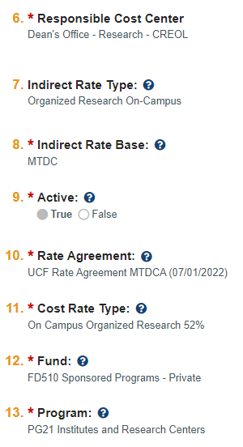


Award Smartform – Related Fields
Budget Allocation
Award Addl. Information
Financial Account

Slide 16
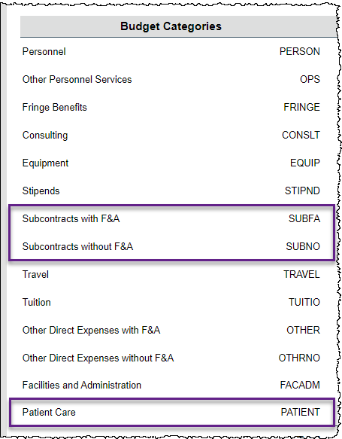
Award SmartForm – Budget Reconciliation
Subcontracts Categories are separate in HRS but combine into one category in Workday
New “Patient Care” category for new awards

Slide 17
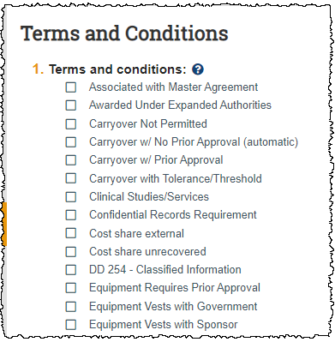
Award SmartForm – Terms & Conditions
Q1. Terms and Conditions – 11 new values added and listed in alphabetical order
Q2. Special Conditions - Workday accepts multiple

Slide 18
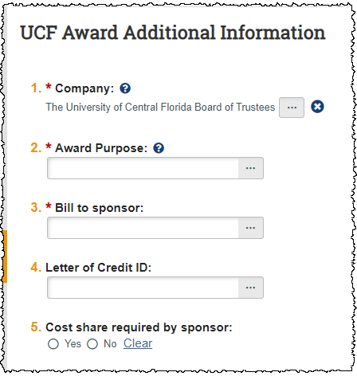
Award SmartForm – UCF Award Addtl Info
Q1. Company – Updated label from “Applicant Institution”
Values are still UCF or RF
Q2. Award Purpose – Now a selection list
One option for OSA
Q3. Bill to Sponsor – New field
Q4. Letter of Credit ID – New field
Q5. Cost Share required by sponsor – new field
Note: VP Org removed; EP Code replaced by “Program” field at Financial Account level.

Slide 19
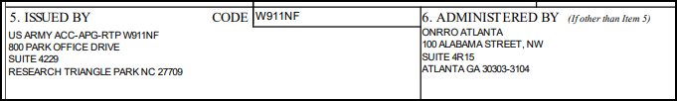
Scenario: Bill-To Sponsor
Most often, the Bill-To Sponsor will be the same as the Direct Sponsor.
In Workday, we can select the appropriate sponsor for each field.
Scenario:
Direct Sponsor = US Army
Bill-To Sponsor = Office of Naval Research

Slide 20
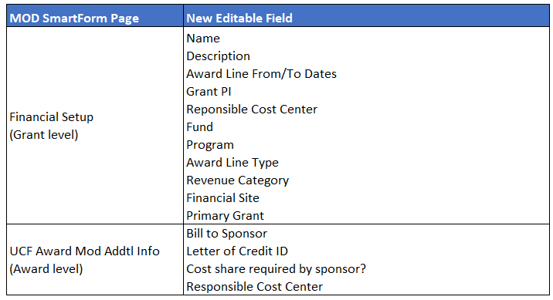
Modification SmartForm – Editable Fields
Existing fields plus:

Slide 21
Modification SmartForm – Editable Fields
Some fields are editable but have considerations to be mindful of:
Can only be changed if no expenditures have occurred
Award Line Type
Revenue Category
Can only be changed if no billing has occurred
Bill-To Sponsor
Letter of Credit ID
If expenditures have occurred, a new grant needs to be created and exp moved, close the old grant
If billing has occurred, a new grant needs to be created and exp moved, close the old grant

Slide 22
Modification SmartForm – Non-Editable Fields
Short Title of Award
Long Title of Award
Instrument Type
Direct Sponsor
Sponsor Award Date
Date Notified of Award
Indirect Cost Type
Indirect Cost Base Type
Rate Agreement
Cost Rate Type
Is this grant for an Outgoing Subaward? And related questions
Is this grant for Cost Sharing?
Company
Award Purpose

Slide 23
HRS Change Management
Responsible Cost Center will default to the PeopleSoft Department selected on the Proposal. Award Managers need to update this value to a Workday Cost Center prior to activating. Departments should confirm this selection.
New “Program” field on the Financial Account page to be completed by Award Managers but confirmed by the Departments.
Since this is a required field, if not known, Award Mgt. will pick PG21 or PG22 based on if Department is a BOG-Approved Institute & Center or not, then will ask for review/update in Dept. Edit Request.

Slide 24
HRS Change Management – Cost Center
Selecting a Responsible Cost Center
PS Departments to WD Cost Centers are 1:Many
Breakout based on Program code (but not in all cases!)
Most Cost Centers have a ‘Research’ option
Example
PS Department = Chemistry
WD Cost Center options:
Chemistry – Academic Instruction
Chemistry – Auxiliary
Chemistry – Research
Chemistry – Academic Administration

Slide 25
HRS Change Management – Cost Center
If PG=21/22 and a Research CC is available, select CC with "- Research"
If PG=21/22, but no Research CC available, should only have one CC, select that.
If PG≠21/22 and there is a CC for that PG, select that, if not, then select Research (1st) or next best CC (like General Administration).
Department should review selection during Department Edits.

Slide 26
Resources and Office Hours
Huron Grants Reference Guides
Terminology Crosswalk
Along with online KV Glossary: https://knightvision.it.ucf.edu/glossary/
FAQs
In Progress with questions received so far and will continue to be updated
Project/Grant ID Crosswalk for Converted Awards
Post WD Go-Live Award IDs start at AWD00005000
Post WD Go-Live Grant IDs start at GR107000
Huron Grants Test (Stage) site
https://mpclkucfstage6.huronclick.com/Grants/

Slide 27
Timeline for Award Managers
June 10th COB – Data entry cutoff for Huron Grants and PeopleSoft
June 24/25/26 Weekend – HRS (all modules) offline
June 27 (Monday) –
Start entering new awards only in Huron Grants (do not Activate)
HRS using new Workday data feeds (e.g., Cost Centers)
July 1 (Friday) –
Start activating on new Awards in Huron Grants
Start entering Mods in Huron Grants (do not Approve)
July TBD – Start approving Mods in HRS

Slide 28
Training Schedule for Post Award Departmental Research Administrators
Thursday, June 16th from 2-3:30pm
Monday, June 20th from 1-2:30pm (repeat content)

Slide 29
Additional Workday Training
General Training Catalog:
https://knightvision.it.ucf.edu/workday-training-catalog-general/
Workday Essentials
WDY100 - "Workday Essentials“
Use Tools and Navigation Workday Search
Reporting Basics
https://knightvision.it.ucf.edu/workday-training-catalog-reporting-basics/
Generate Reports Access Dashboards
Specialty Areas Training

Slide 30
Workday Demo

